Slide 1
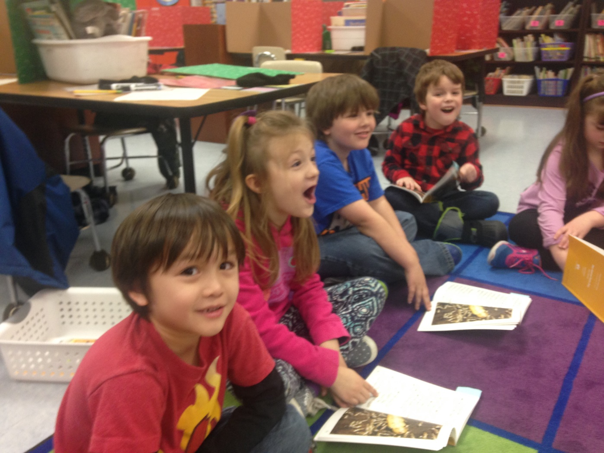
Providing Tailored K-5 Reading Instruction
Using the Core Knowledge Language Arts (CKLA)
Assessment and Remediation Guide (ARG)

Slide 2
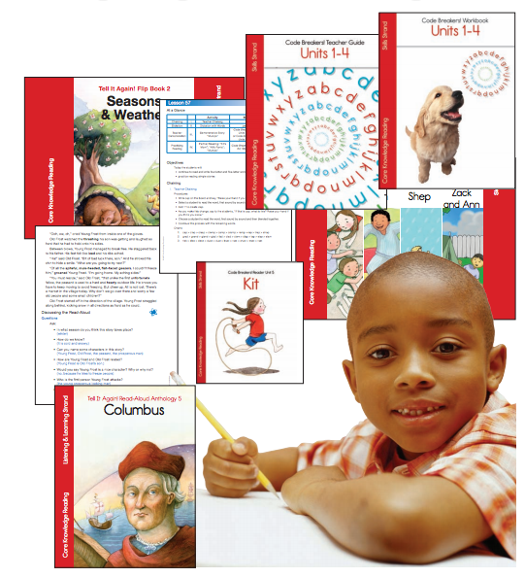
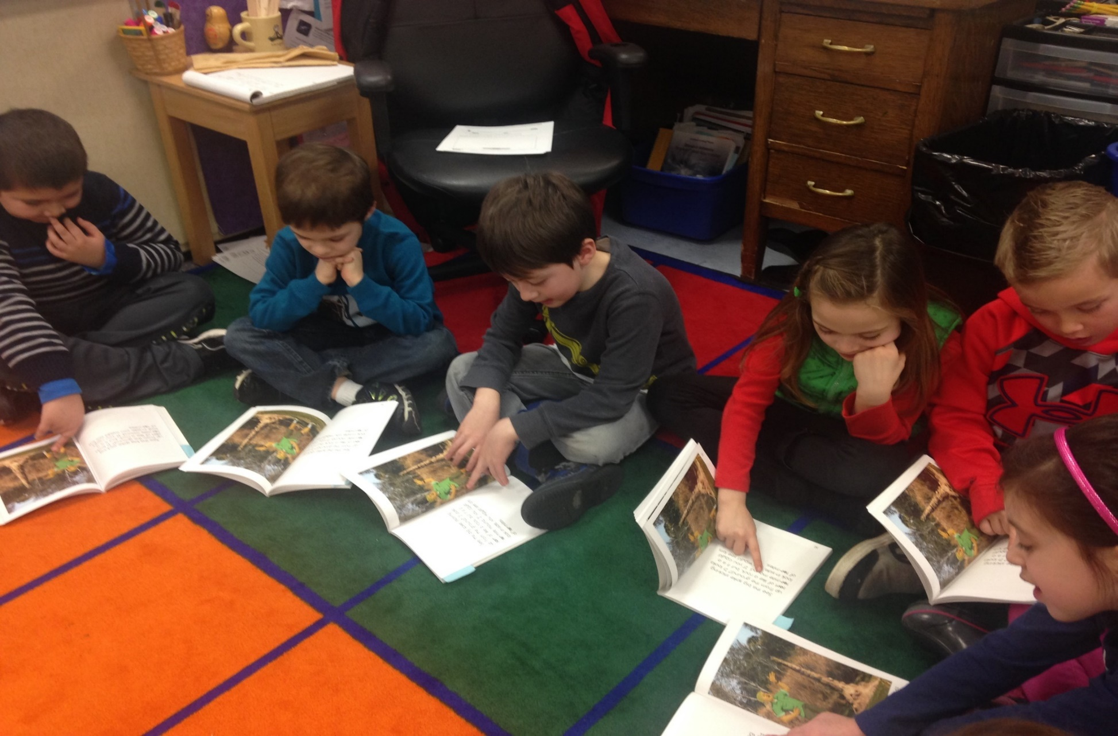
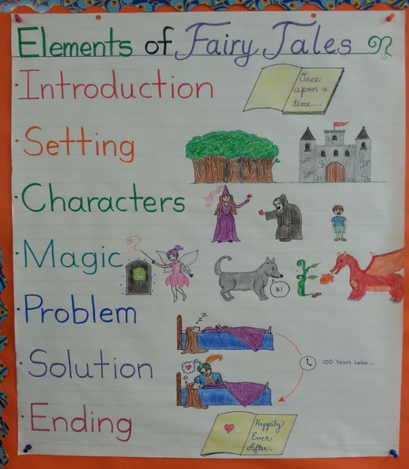
Core Knowledge Language Arts (CKLA) is the adopted K-5 ELA curriculum

Slide 3
Background
Literacy Intervention and Remediation
Literacy intervention for young readers is a top priority in the SSD.
We believe:
Struggling readers must be identified as soon as possible,
Literacy intervention must then be delivered as swiftly as possible,
Literacy intervention must be customized to every learner and adapt with progress,
Instructional modification and progress monitoring must be automated so that teachers can stay focused on core literacy blocks and instruction,
Data must be frequent, meaningful and actionable,
Teachers must remain in the equation, capable of observing and responding to readers in real time,
All third graders must read at grade level as an essential step toward increasing the number of children who are career and college ready.

Slide 4
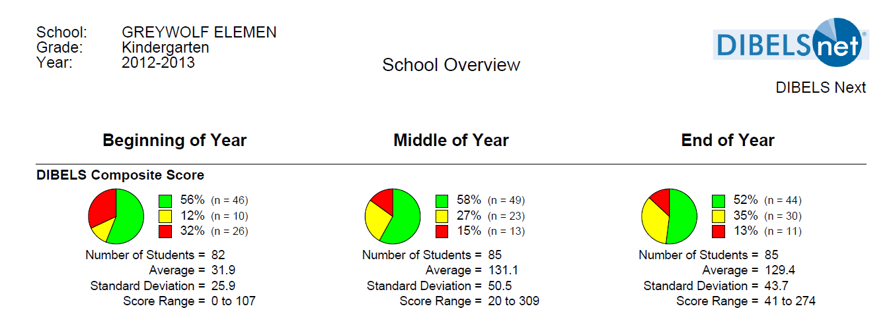
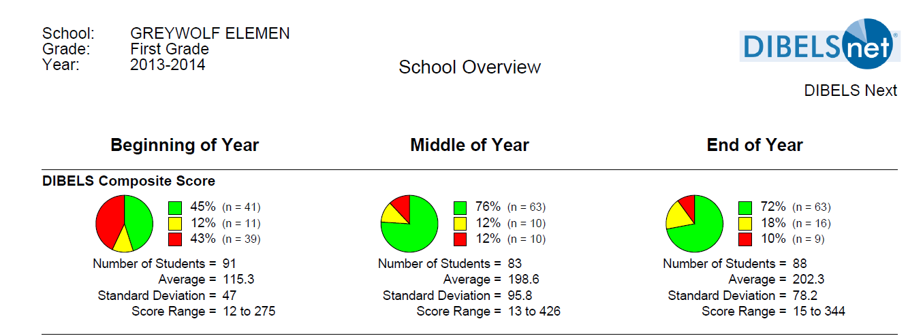
The following slides follows the GW kindergarten class that was first administer the Dynamic Indicators of Basic Early Literacy Skills (DIBELS) in 2012 to the present:
Notes:
A snapshot of reading achievement in the US (NAEP,2015) 36% of the 4th graders are at or over the Proficiency l achievement levels

Slide 5
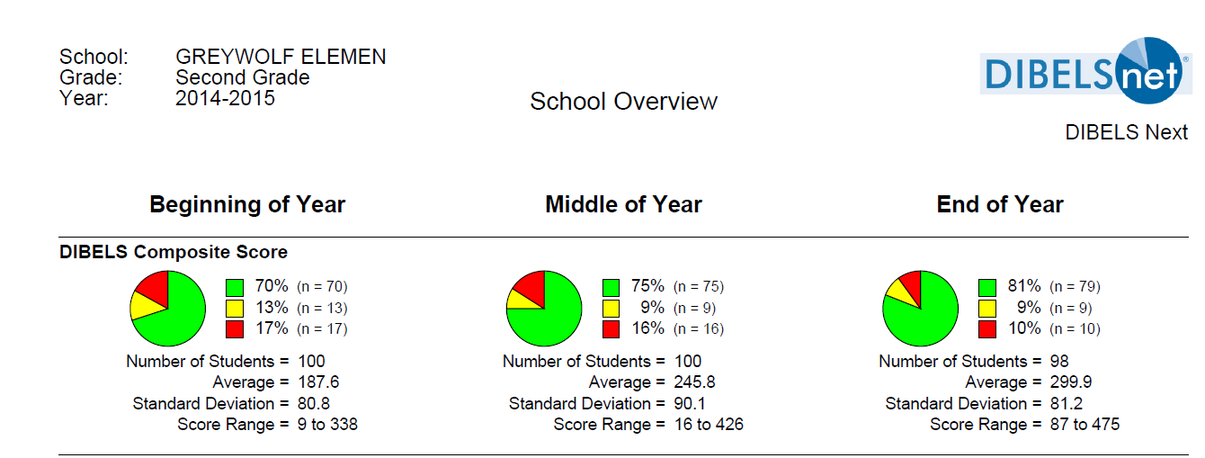
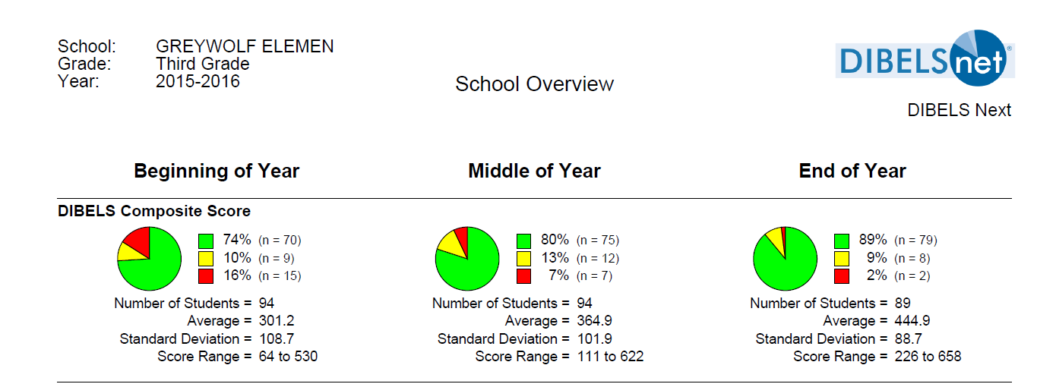

Slide 6
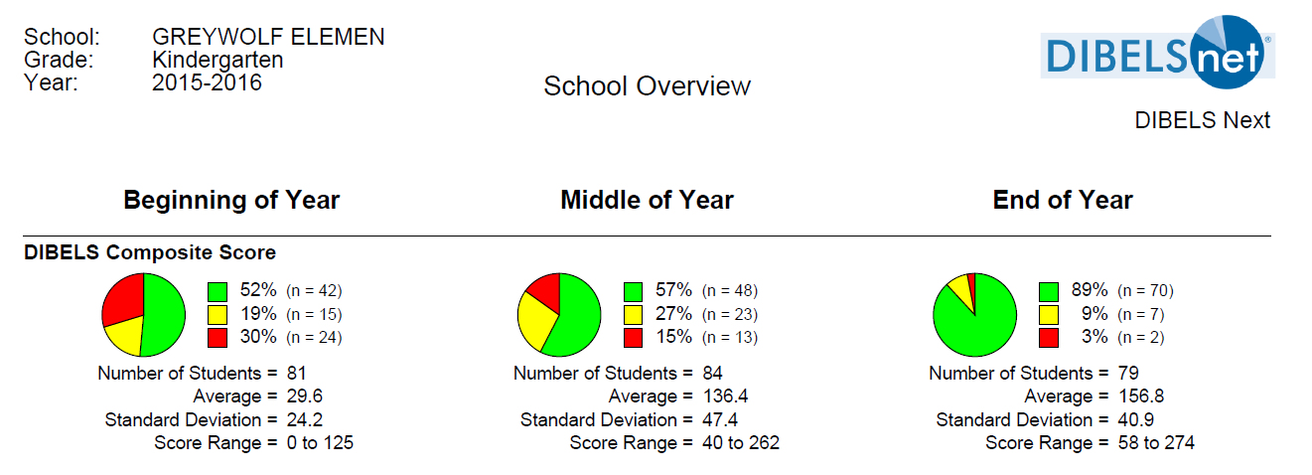
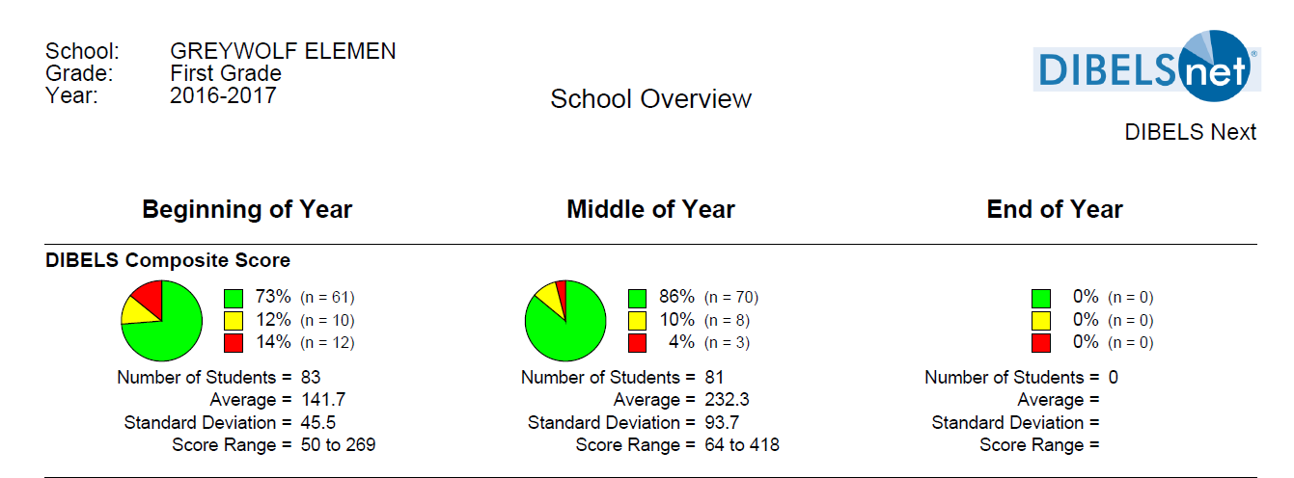
This slide shows the growth with our 1st full day Kindergarten class using CKLA (ARG) and how they are doing mid-year 1st grade 2017:
Notes:
This the first year Haller is using DIBELS with fidelity and their score is great as well….
Haller mid-year 1st graders are at 73%

Slide 7
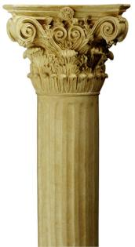
CKLA Three Pillars Overview
1. Listening and Learning Strand
2. Skills Strand (in grades 4 & 5 the strands are combined)
3. Additional Support Strand- Dynamic time to meet needs of students/round out curriculum: fill-in holes, reinforce, stretch and enrich (small group instruction /literacy centers)
Notes:
Supporting students where they are…

Slide 8
Pillar 1: The Listening & Learning Strand
Supporting Language and Knowledge Development through Shared Interactive Reading
            Complex text- above what they can read on their own
            Word work – focused, text-based vocabulary study
            Building knowledge with text sets on rich, relevant topics
            Build knowledge of concepts
            It is important to note:
            All students participate in the Listening & Learning sessions on grade level, regardless of their decoding skills.
Limited decoding skills will not prevent the student from learning from read-alouds, discussions…
The goal is for all students to be exposed to the vocabulary, content, and language in the read-alouds texts at their grade level.
8
Notes:
Key Points:
This sub-section will address support in the Listening and Learning strand for language and knowledge development.
Notes:
Pillar 1: The Listening and Learning Strand: Supporting Language and Knowledge Development through Shared Interactive Reading.

Slide 9
Pillar 2: The Skills Strand
              Reading and writing are taught in tandem, reinforcing each other.
              Decodable readers are 100% decodable—made up entirely of words and sounds the students have been taught.
9

Slide 10
Pillar 2: The Skills Strand
(Foundation Skills)
              “While there are many competencies required to be a successful reader able to comprehend, analyze, and synthesize what one reads, one of the key prerequisite components is the ability to automatically apply knowledge of the English letter-sound correspondences when reading unfamiliar text.”
              ARG
A&R Guides
10

Slide 11
Pillar 3:Additional Support
Dynamic time to meet needs of all students and round out curriculum
              Targeted Instruction:
                ARG
11
Notes:
Supporting students where they are…
Guided reading
Accountable Independent reading
Enrichment
Writers Workshop (recommendation no more than 2 days a week k-2)
dependent Reading:
Choice and volume of reading
Apply decoding and comprehension skills
Opportuty for additional support

Slide 12
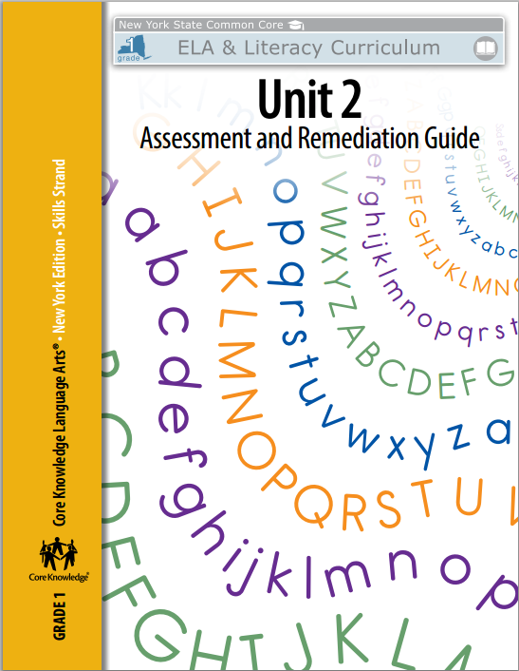
What is the role of the CKLA ARG in literacy instruction?
Tool that provides:
Built-in high support scaffolds to differentiate Skills instruction,
Support for tailoring a specific lesson,
Support for small group,
  time within the skills block,
  support within pillar 3 (small group/center).

Slide 13
What will teachers find in the ARG?
The ARG is a comprehensive guide for each skill :
Lesson Templates
Word /Chaining Lists
Activities for Reteaching
Practice Sentences and Stories for Oral Reading
Games for Reinforcement
Progress Monitoring Assessments
Resources –End of Section Stories and Fluency Assessment
Notes:
Key Points:
The A&R Guide is a comprehensive guide that includes:
Sample Lessons
Word /Chaining Lists
Activities for Reteaching
Games for Reinforcement
Progress Monitoring Assessments
Resources
Let’s look at samples of each of these features now.

Slide 14
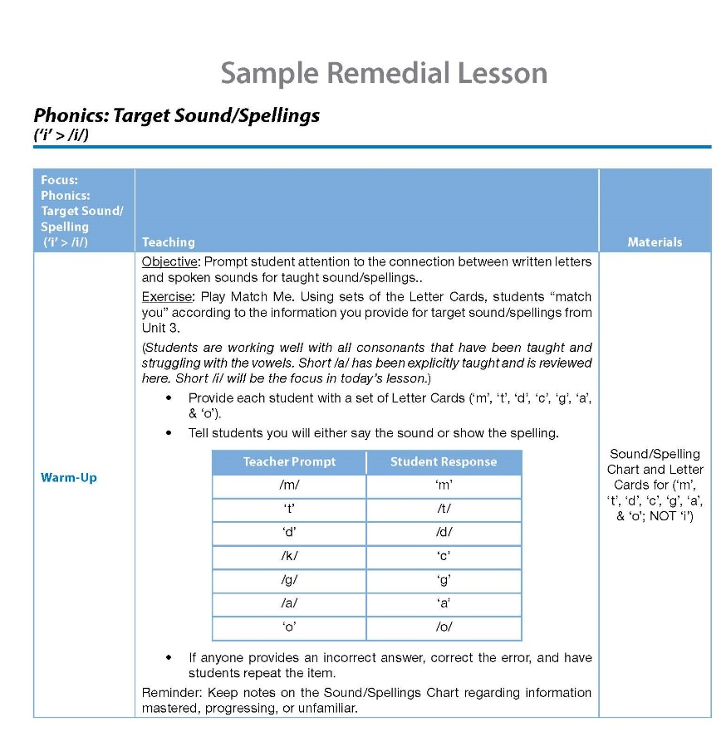
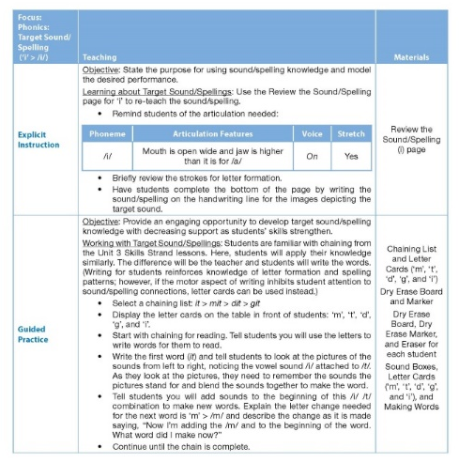
Lesson Templates and Lesson Samples
Templates & Lesson samples
Guided reinforcement
Explicit reteaching
Comprehensive reteaching
Notes:
Key Points: K & 1st The A&R Guide offers the guidance to helping you determine a student’s level of instructional need.
There are three levels of instructional need defined by the Guides.
1) The first is Guided Reinforcement, which is a fifteen minute lesson to help students strengthen a skill that has already been taught, but with which the child requires extra practice.
2) The second level of instructional need is Explicit Reteaching, which provides students with 25 minutes of practice on any skill.
3) The third level is Comprehensive Reteaching, which is a 45 minute lesson used when a student is one grade below level, and requires reteaching in more than one skill.
All three levels are defined in the Guides for particular skills and samples of lessons are provided alongside lesson templates to guide your planning and building of lessons that fit the specific needs of individual students or small groups.
**The A&R Guides for grades 2–3 and the Encoding and Decoding Guide for grades 4–5 include one type of lesson template. This lesson plan is almost a hybrid of the explicit reteaching and comprehensive reteaching lesson templates (found in grades K–1), offering flexibility when planning instruction (e.g., 25–45 minutes). In most cases students would need this level of support since the skills being taught were originally introduced in a previous grade level. The only exception may be grade 2 (when using the A&R Guide to support current instruction). In cases such as this, teachers may use the A&R Guide resources for additional guided practice (e.g.., 15 minute guided reinforcement lesson).

Slide 15

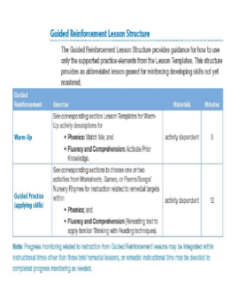
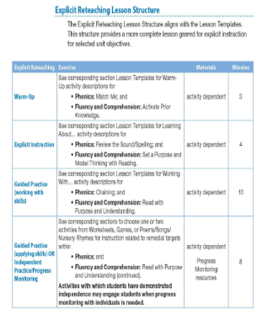
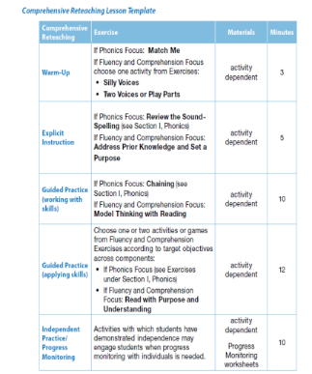
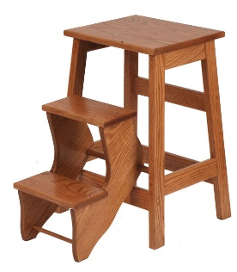
What are the differences between the various remediation lessons supported by the ARG and the students that are best served by each type of lesson?
Models of Instruction
Guided
Reinforcement
Explicit
Reteaching
Comprehensive
Reteaching
Notes:
Key Points:
There are three model types for using the A & R guide. They include guided reinforcement, explicit reteaching, and comprehensive reteaching
Guided Reinforcement is the level of instructional need for students who are overall on pace, but demonstrate some gaps in knowledge.
Explicit Reteaching should be used when students require explicit instruction in a specific component area of literacy such as phonological awareness, phonics, comprehension, fluency or writing
Comprehensive reteaching happens when students require instruction over multiple components areas of literacy.

Slide 16
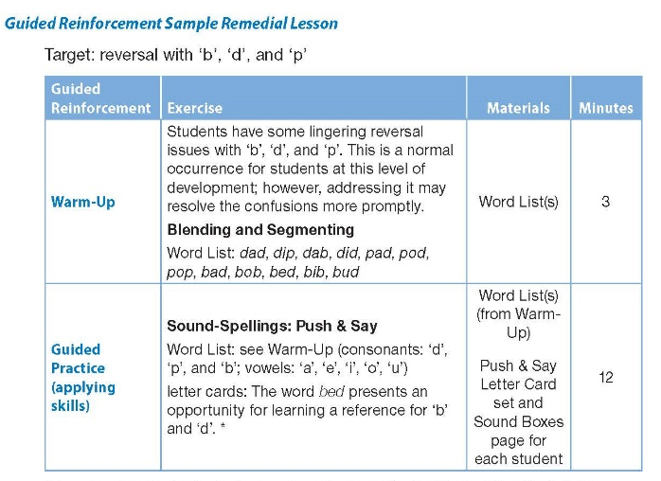

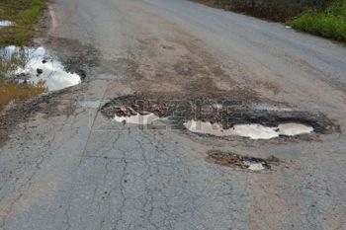
Guided Reinforcement Lessons
Short sequence of instruction allowing students to keep on pace
Appropriate for:
    On-grade level students with instructional gaps
    Reteaching a skill
    Small group time (within/outside of Skills block)
patching a hole
Notes:
Key Points:
Guided reinforcement should be used when students demonstrate incomplete mastery of specific skills. Think of it as patching a hole, wherein a relatively short sequence of specific instructional attention will allow students to keep on pace with their peers. It will require additional guided practice, during temporary individual or small group time, on an as needed basis. Guided Reinforcement should be used when students demonstrate incomplete mastery of specific skills.
Remediation requires a relatively short sequence of specific instruction in addition to the core classroom literacy instruction which will allow students to keep on pace with their peers.
This level of need tends to be met by differentiated classroom instruction or remediation may be provided during temporary individual or small group time.
Appropriate for:
On grade-level students with instructional gaps
Short lesson sequences focusing on particular skills
Can be used for reteaching a skill
Can be done within a classroom during small group time

Slide 17
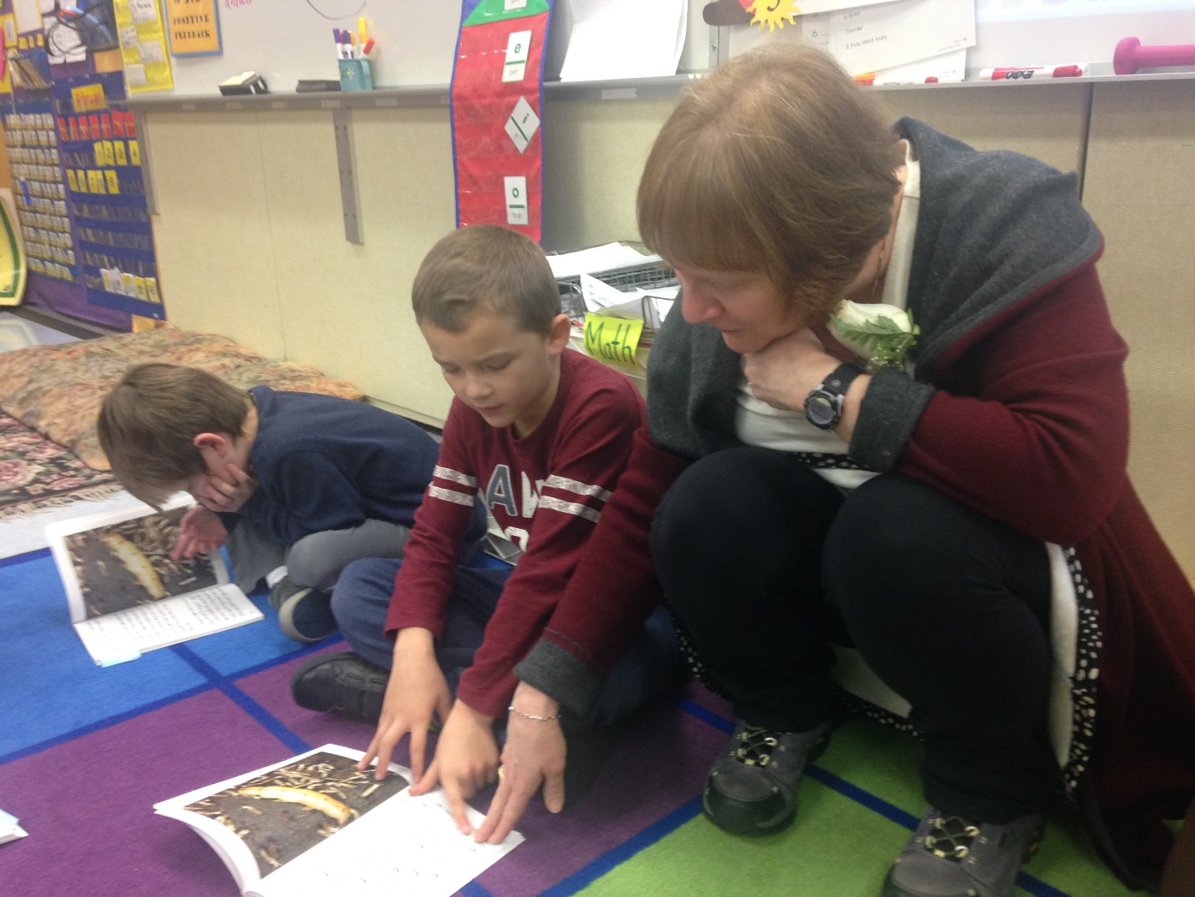
Guided Reinforcement Lessons
Notes:
Key Points:
Guided reinforcement should be used when students demonstrate incomplete mastery of specific skills. Think of it as patching a hole, wherein a relatively short sequence of specific instructional attention will allow students to keep on pace with their peers. It will require additional guided practice, during temporary individual or small group time, on an as needed basis. Guided Reinforcement should be used when students demonstrate incomplete mastery of specific skills.
Remediation requires a relatively short sequence of specific instruction in addition to the core classroom literacy instruction which will allow students to keep on pace with their peers.
This level of need tends to be met by differentiated classroom instruction or remediation may be provided during temporary individual or small group time.
Appropriate for:
On grade-level students with instructional gaps
Short lesson sequences focusing on particular skills
Can be used for reteaching a skill
Can be done within a classroom during small group time

Slide 18
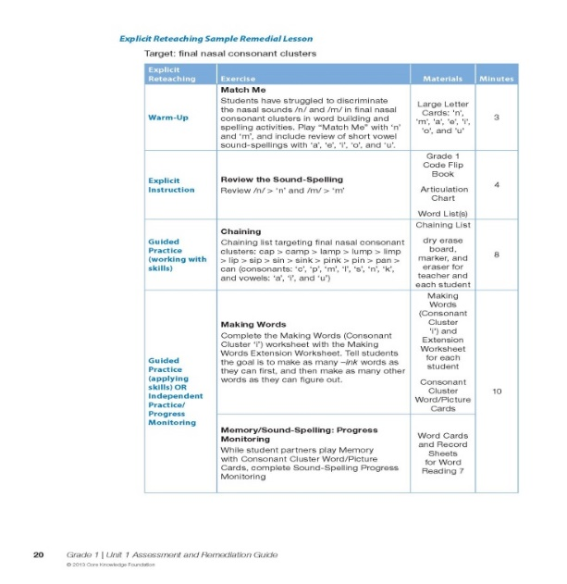

Explicit Reteaching Lessons
Explicit instruction in an area of literacy
Committed time working with student(s)
Appropriate for:
Below grade-level students
Students who need some intervention to stay on track
Best as intervention instruction
repair
Notes:
Key Points:
Explicit reteaching should be used when students require explicit instruction in a component area of literacy (i.e., phonological awareness, phonics, comprehension, fluency, or writing).
Either initial explicit instruction was missed or did not suffice to produce student understanding.
Most aspects of literacy development are on pace, but specific component areas require more than additional guided practice.
It will require committed time for explicit instruction with individuals or small groups.
This level of need tends to be met by intervention instruction.
Appropriate for:
Below grade-level students
Students needing consistent extra help
Students who need some intervention to stay on track
Best done as intervention instruction

Slide 19
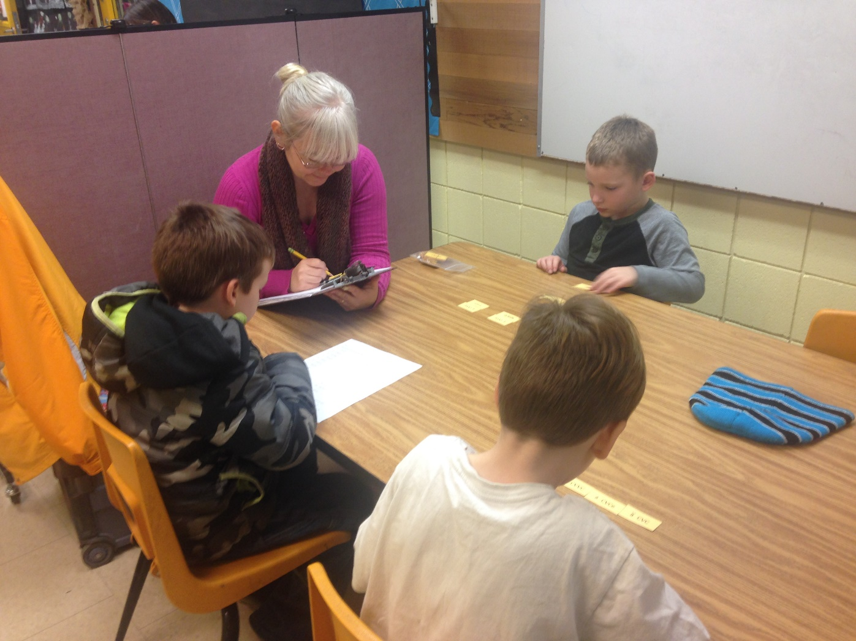
Explicit Reteaching Lessons
rep
Notes:
Key Points:
Explicit reteaching should be used when students require explicit instruction in a component area of literacy (i.e., phonological awareness, phonics, comprehension, fluency, or writing).
Either initial explicit instruction was missed or did not suffice to produce student understanding.
Most aspects of literacy development are on pace, but specific component areas require more than additional guided practice.
It will require committed time for explicit instruction with individuals or small groups.
This level of need tends to be met by intervention instruction.
Appropriate for:
Below grade-level students
Students needing consistent extra help
Students who need some intervention to stay on track
Best done as intervention instruction

Slide 20
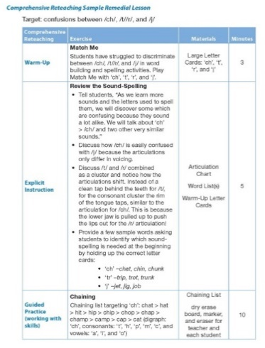
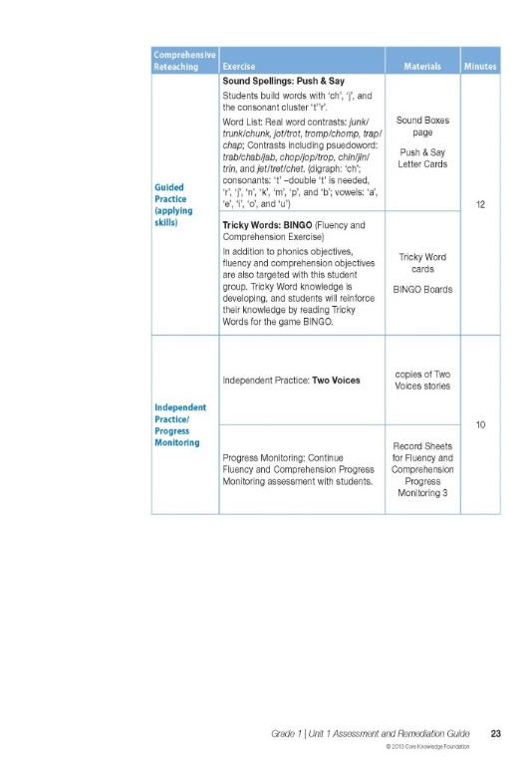
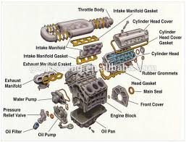
Comprehensive Reteaching Lessons
Explicit instruction across multiple literacy areas
Significant committed time working with student(s)
Appropriate for:
Students with IEPs
Students at least one grade level behind
Can be used as a substitute for Teacher’s Guide lesson
Rebuilding
Notes:
Key Points:
Comprehensive reteaching should be used when students require explicit instruction across multiple component areas of literacy (i.e., phonological awareness, phonics, comprehension, fluency, or writing).
These students tend to have instructional needs preventing them from keeping up with the lesson sequence in the Teacher Guides.
Significant adaptations or alterations to the instructional plan are needed.
It will require significant committed time for comprehensive instruction with individuals or small groups.
This level of need tends to be met by intense intervention or individualized education plans serviced through Special Education.
Students who are significantly below grade level will most likely need to continue with instruction from subsequent units of the Assessment and Remediation Guide as they continue to work toward grade level benchmarks.
Appropriate for:
Students with IEPs
Students needing a consistent double dose of reading instruction
Students at least one grade level behind
Can be used by push-in and pull-out teachers
Can be used as a substitute for the Teacher’s Guide lesson

Slide 21
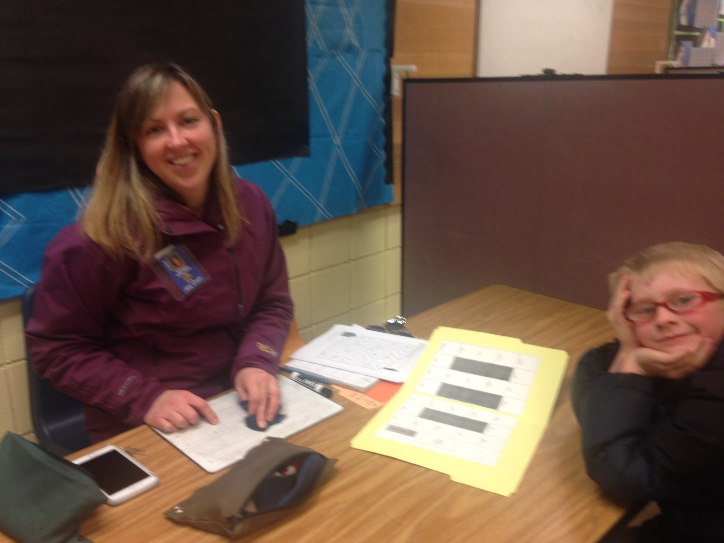
Comprehensive Reteaching Lessons

Slide 22
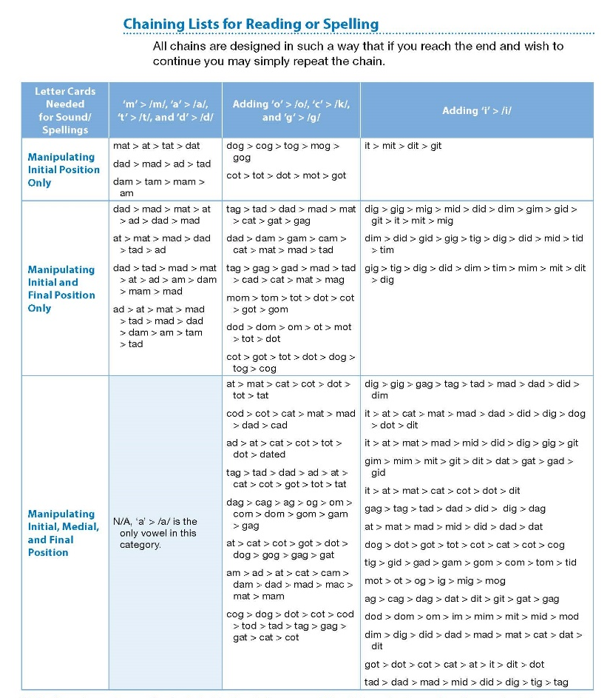
Word & Chaining Lists
Practice mastery of letter-sound correspondences
Notes:
Key Points:
The A&R Guides include words lists and chaining lists that teachers can build into a lesson for students to use in order to practice mastery of letter-sound correspondences identified as weaknesses.
These lists include words that are aligned to the specific letter-sound correspondences taught up to the specified unit.
Examples of using these lists include:
Teachers might copy a word list and attach it to a pocket chart. Students can then work with a partner while one reads the words from the chain and the other student builds the word with letter cards in the pocket chart.
Teachers might use the lists at writing centers specifically for “chain and copy” exercises. Students form pairs and they take turns as one student reads a words in a chain and the other student writes the words on paper—switching to complete a new chain.

Slide 23
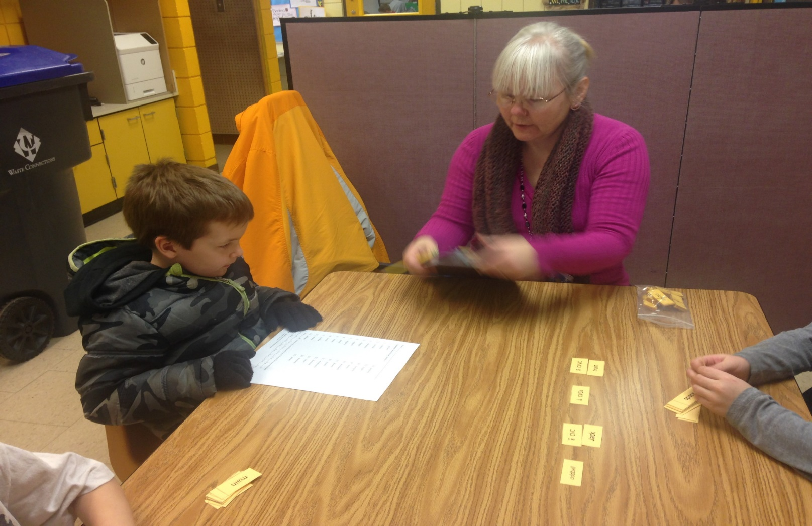
Word & Chaining Lists
Practice mastery of letter-sound correspondences
Notes:
Key Points:
The A&R Guides include words lists and chaining lists that teachers can build into a lesson for students to use in order to practice mastery of letter-sound correspondences identified as weaknesses.
These lists include words that are aligned to the specific letter-sound correspondences taught up to the specified unit.
Examples of using these lists include:
Teachers might copy a word list and attach it to a pocket chart. Students can then work with a partner while one reads the words from the chain and the other student builds the word with letter cards in the pocket chart.
Teachers might use the lists at writing centers specifically for “chain and copy” exercises. Students form pairs and they take turns as one student reads a words in a chain and the other student writes the words on paper—switching to complete a new chain.

Slide 24
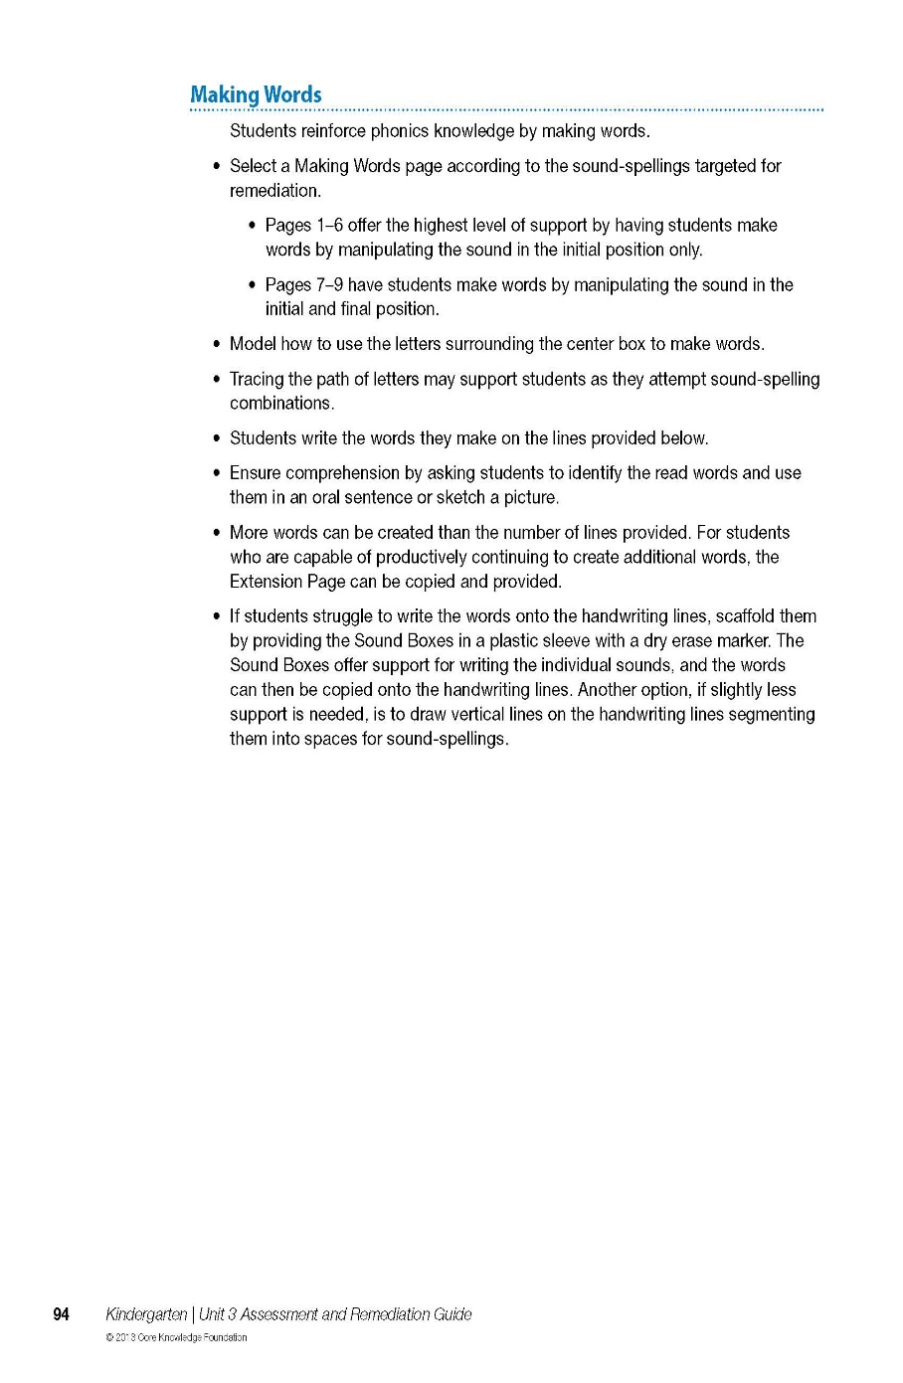
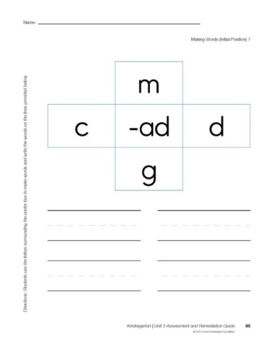
Reteaching Activities
Facilitated by teacher
Goal - strengthen and support instruction
Activities vary:
  familiar (from TG)
  adapted
  new
Notes:
Key Points:
The A&R guide includes activities to be used for reteaching.
The expectation is to have these activities facilitated by the teacher.
Some activities are familiar to the ­­­students from the Teacher Guides; others have been adapted or are new.
These activities are engaging and the purpose of these is to strengthen and support instruction and to have a back-and-forth exchange between student and teacher.
For example, there are worksheets for some activities to support the structure of the lesson and the teacher is intended to work alongside the students, providing in-the-moment guidance and feedback for remediation. This is what will help to increase a student’s level of success with the focus skill.
Some activities are carried over from the Teacher Guides (e.g., Chaining), some are adapted (e.g., applying the Baseball Gameto varied content), and some are new to allow for fresh instruction (e.g., working with Sound Boxes).

Slide 25
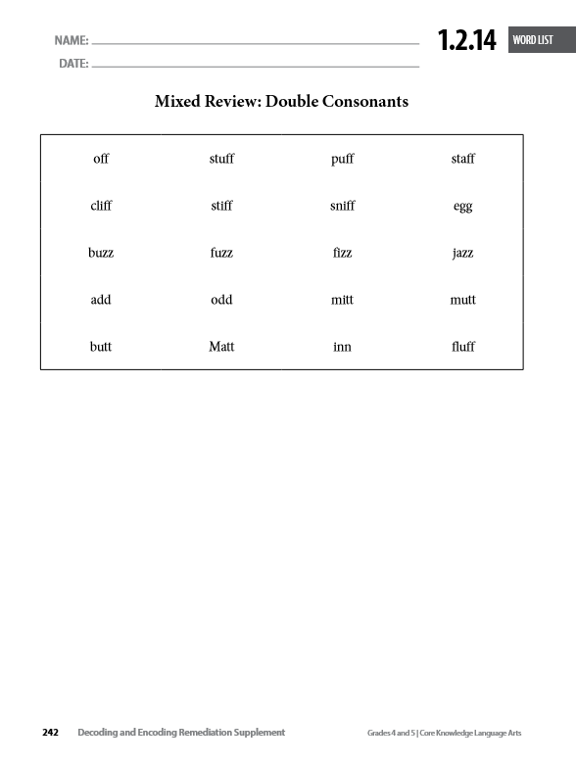
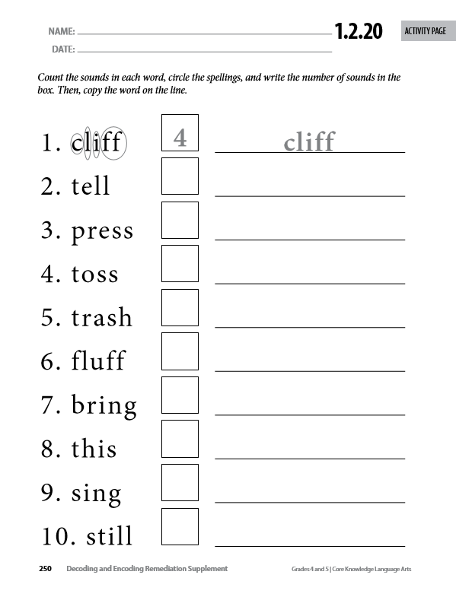
Word Lists Activity Pages

Slide 26
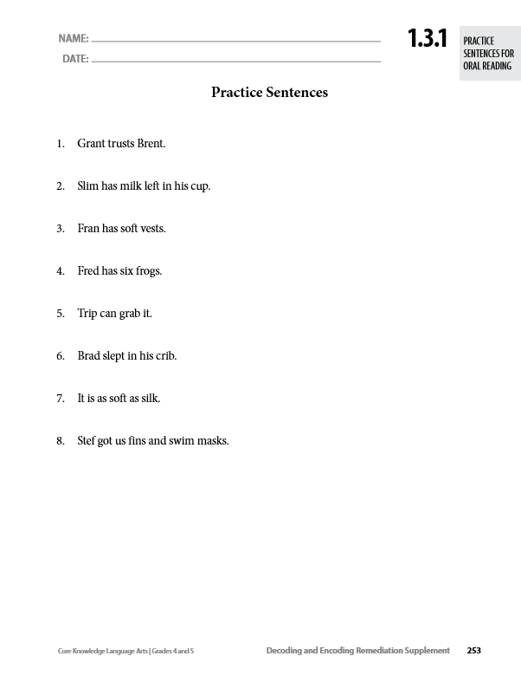
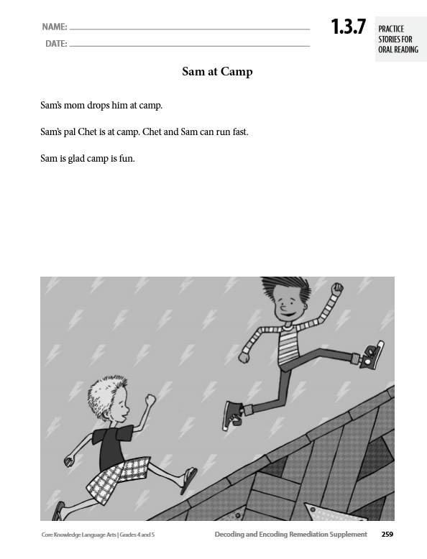
Practice Sentences Practice Stories

Slide 27
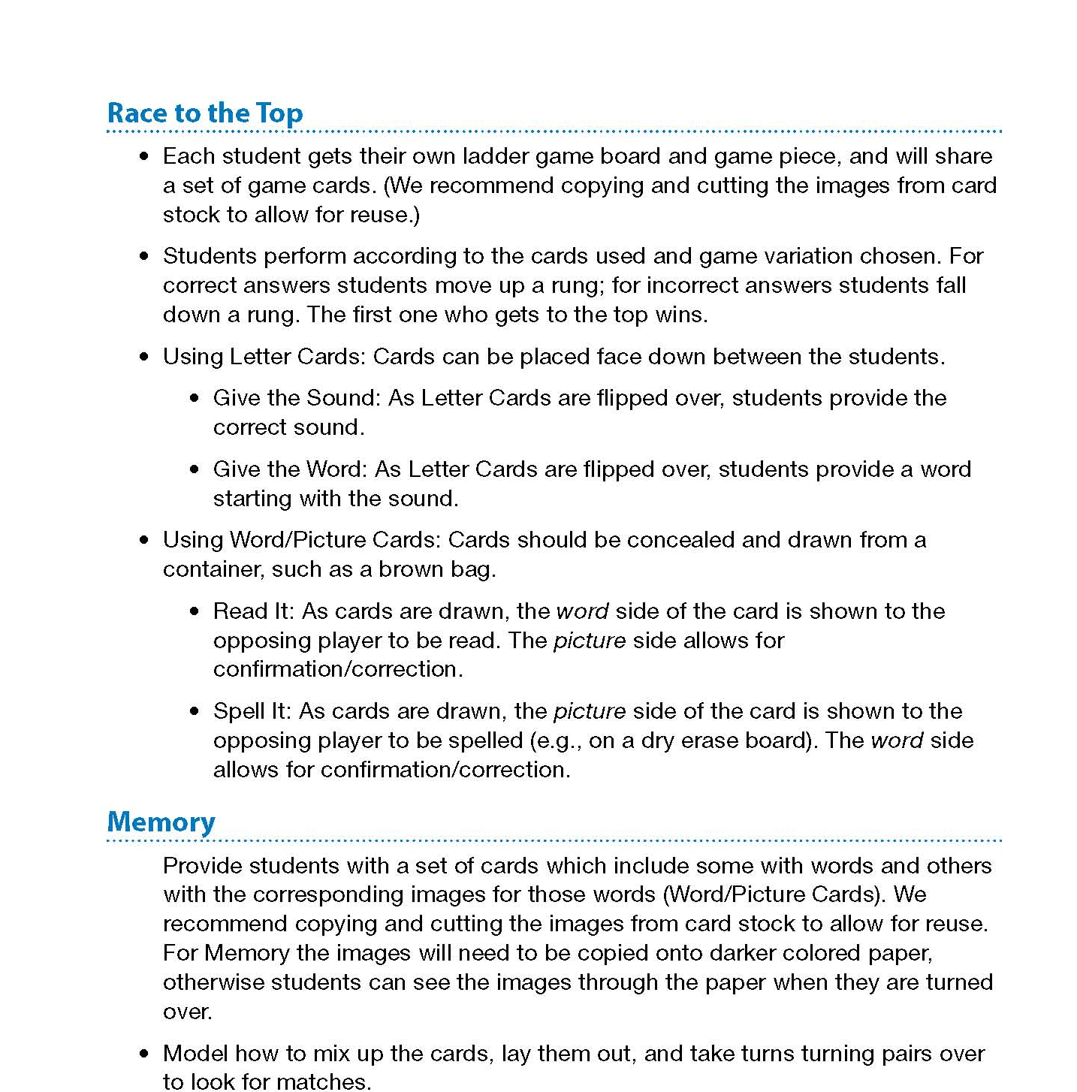
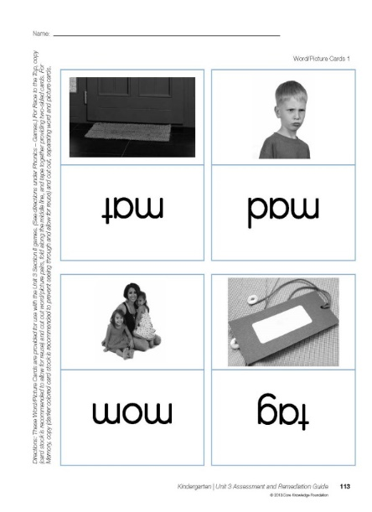
Games for Reinforcement
Skills aligned games are included to provide opportunities for students to practice
  small group instruction
  center work
Notes:
Key Points:
Skills-aligned games are included to provide engaging and differentiated opportunities for students to practice targeted skills in small group instruction or during center work.
Teachers will need to make/prepare these games in advance. Templates and instructions are provided for each suggested game.
These are referred to during the Pausing Point sections of the Teacher Guides and/or A&R Guides.

Slide 28
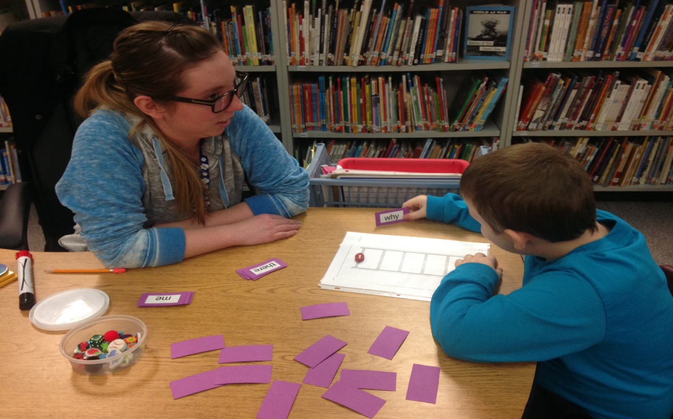
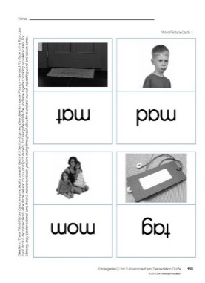
Games for Reinforcement
Skills aligned games are included to provide opportunities for students to practice
  small group instruction
  center work
Templates & instructions are provided.
Notes:
Key Points:
Skills-aligned games are included to provide engaging and differentiated opportunities for students to practice targeted skills in small group instruction or during center work.
Teachers will need to make/prepare these games in advance. Templates and instructions are provided for each suggested game.
These are referred to during the Pausing Point sections of the Teacher Guides and/or A&R Guides.

Slide 29
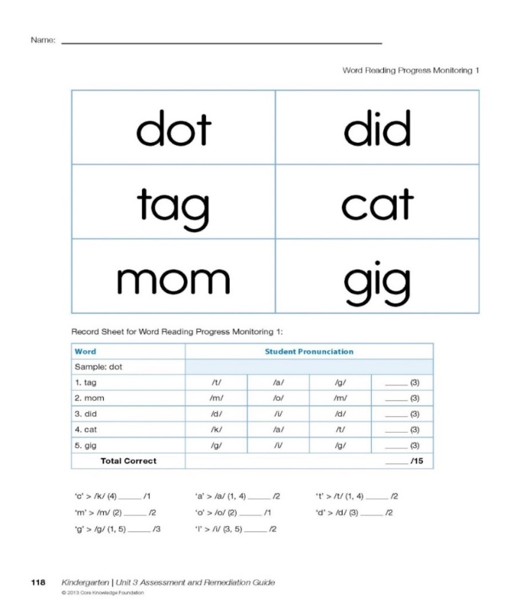
Progress Monitoring Assessments
Progress Monitoring Assessments
Monitor student progress on targeted skills
Diagnostically inform instruction
Contribute to student performance records
Notes:
Key Points:
Placement and Student Performance Assessments are provided in the Teacher Guides. To supplement these, the A&R Guide provides Progress Monitoring Assessments specific to each skill you may be targeting for remediation.
These assessments can be used diagnostically to inform instruction and systematically to contribute to a record of student progress.

Slide 30
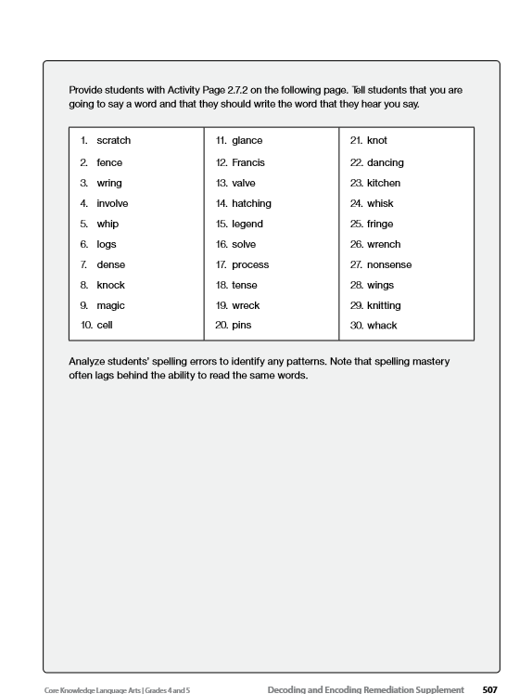
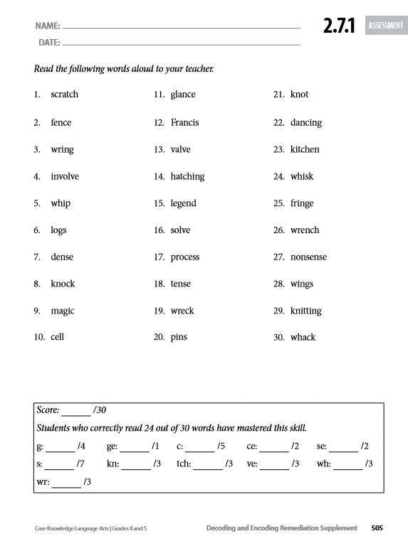
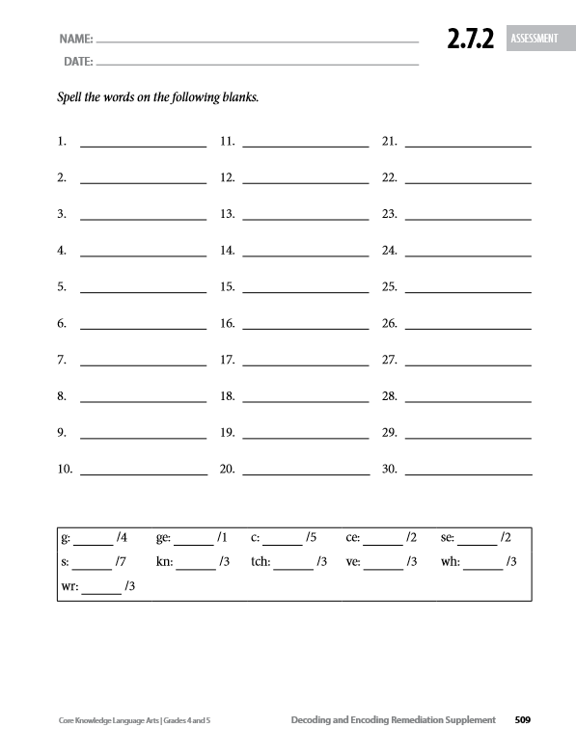
Assessment

Slide 31
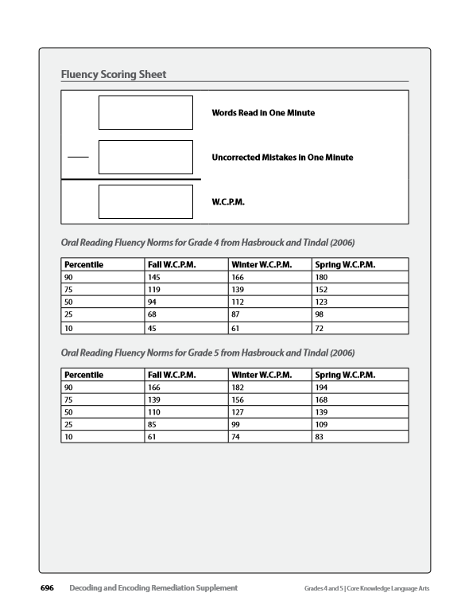
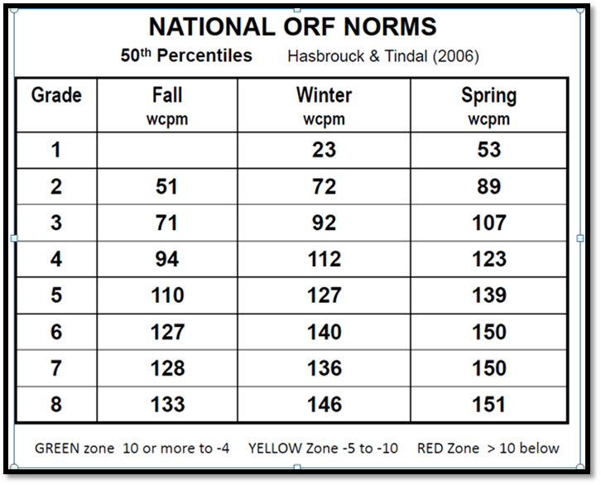
Fluency Assessments

Slide 32
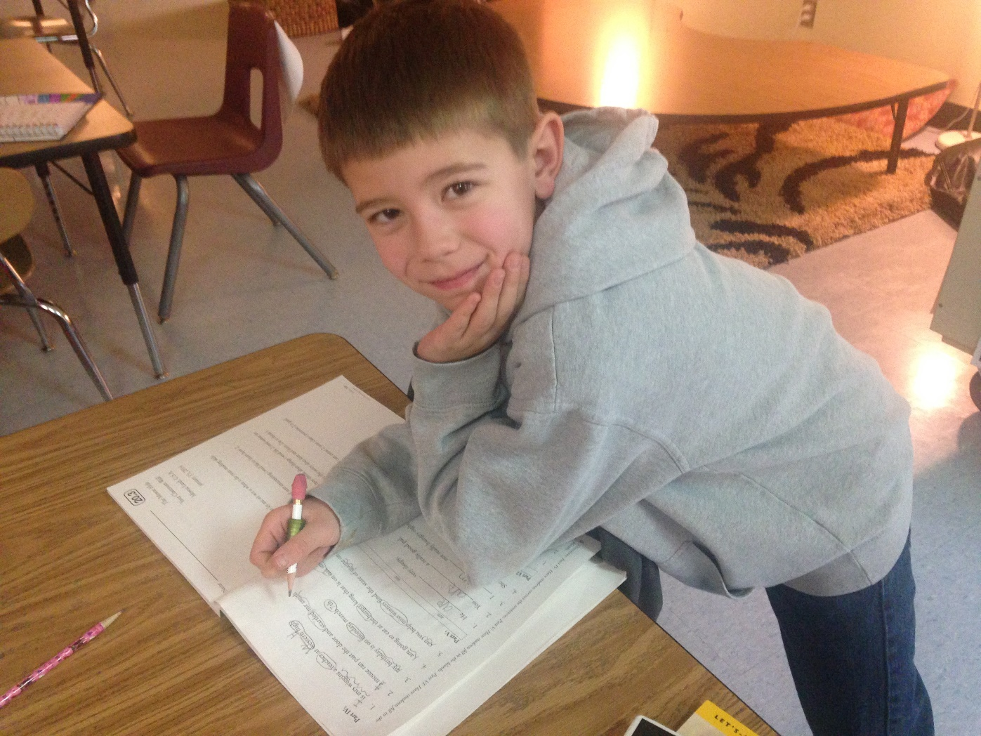
Progress Monitoring Assessments
5. Progress Monitoring Assessments
Monitor student progress on targeted skills
Diagnostically inform instruction
Contribute to student performance records
Notes:
Key Points:
Placement and Student Performance Assessments are provided in the Teacher Guides. To supplement these, the A&R Guide provides Progress Monitoring Assessments specific to each skill you may be targeting for remediation.
These assessments can be used diagnostically to inform instruction and systematically to contribute to a record of student progress.

Slide 33
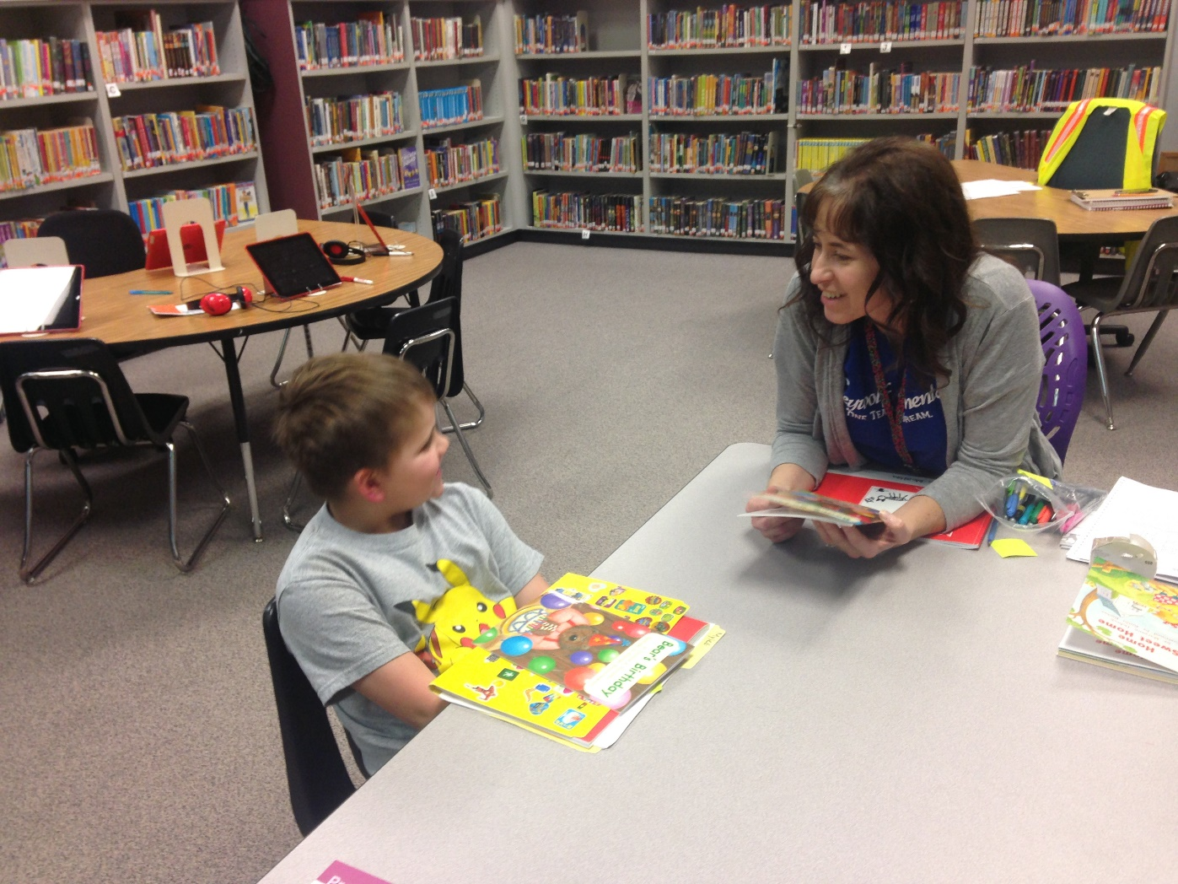
Fluency Assessments

Slide 34
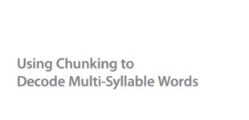
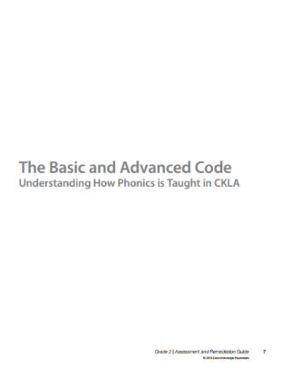
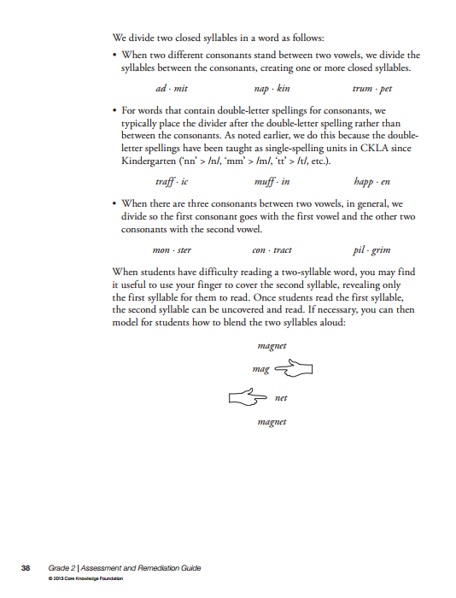


Resources
CKLA instructional aligned articles
Comprehension Master Thinking with Reading Chart
Sound articulation chart
Decoding strategies
Concepts of Print checklist
Notes:
Key Points:
There are also additional resources included in the Assessment and Remediation Guide.
These include articles that provide the rationale for how we teach CKLA Skills, which are also included in the appendices in the back of the Teacher’s Guides.
However, other resources won’t be found in the Teacher Guides, but can be a huge support for instruction; these include:
an Articulation Chart to help you guide students in becoming aware of what their lips, tongue and voice boxes are doing when they say sounds,
a Figuring Out Words Chart with some decoding strategies that can be posted,
a Comprehension Master Thinking with Reading Chart with before/during/after reading strategies, and
a Concepts of Print Checklist that can be used when assessing students in this area.

Slide 35

Assessment is a prerequisite first step to helping struggling readers, we use multiple measures to diagnose students’ areas of improvement
Utilize DIBELS, MAPS, iReady Assessment Data, CKLA Skills Unit Assessments, CKLA Domain Assessments, formative assessments, and anecdotes to diagnose students' areas of improvement.

Slide 36

We believe struggling readers must be identified as soon as possible

Slide 37



Step 1: Determining child’s Needs
We believe Literacy intervention must then be delivered as swiftly as possible and must be customized to every learner.
Sample from Assessment Flowchart
Class Summary Form
every learner and adapt with progress
Interpretation Guidelines

Slide 38
Planning Remediation
When assessment data and instructional performance signals a need for remediation:
Go to the corresponding instructional point in the ARG.
Consider the students’ level of instructional need and plan with the lesson structures accordingly.
Select exercises and prepare associated materials from the appropriate section(s) of the ARG.
Use progress monitoring assessments to inform decisions about student progress and/or ongoing remediation needs.
Notes:
Key Points:
Based on the instructional needs of your students, the Assessment and Remediation Guide will provide a path for how to plan remediation.
Say:
1. K and Grade 1 A&R Guides correspond unit by unit and the Table of Contents for the Grade 2 A&R Guide will guide you to the section(s) you need.
2. In the K and Grade 1 A&R Guides, Determining Student Need charts will help you confirm you are in the right place.
3. ALWAYS cross-check with the Scope and Sequence to ensure remediation is starting at the earliest point of need. A Scope and Sequence is provided in the Introduction for the K and Grade 1 A&R Guide and the Table of Contents serves as a Scope and Sequence for the Grade 2 A&R Guide.
4. In K standard lesson templates and samples are provided throughout the A&R Guide sections. Guidance is provided in the Introduction for adapting the templates for either more abbreviated or more comprehensive instruction.
5. In Grade 1 lesson templates and samples are provided for all three instructional levels throughout the units and sections.
6. In Grade 2 standard lesson templates and samples are provided. These may be adapted for more abbreviated instruction (reference the K Introduction if guidance is needed). If more comprehensive instruction is required, resources from prior grade levels are recommended.

Slide 39



We believe planning tailored instruction with the Assessment and Remediation Guide is the opportunity to make a difference in the lives of ALL our readers!!

